Slide 1
SEARCH FOR THE SMART CHOICE OF RESTAURANT AS A BUSINESS IN NYC
Raja Soman

Slide 2
Which restaurant business should I get into?
This question further has associated questions to be answered
Which cuisines are prevalent in NYC?
Which cuisines are relatively absent in NYC?
Where is cuisine absenteeism seen the most?
Which sensible selections could be made as cuisines of choice for the business?
Which sensible boroughs of NYC could be chosen as target locations?

Slide 3
Where do I get the data for my analysis?
Open source data is the best bet
Foursquare API ran into issues of “Quota error” and hence there was uncertainty
The nyc.gov website is an excellent choice to get geographical data on NYC restaurants

Slide 4
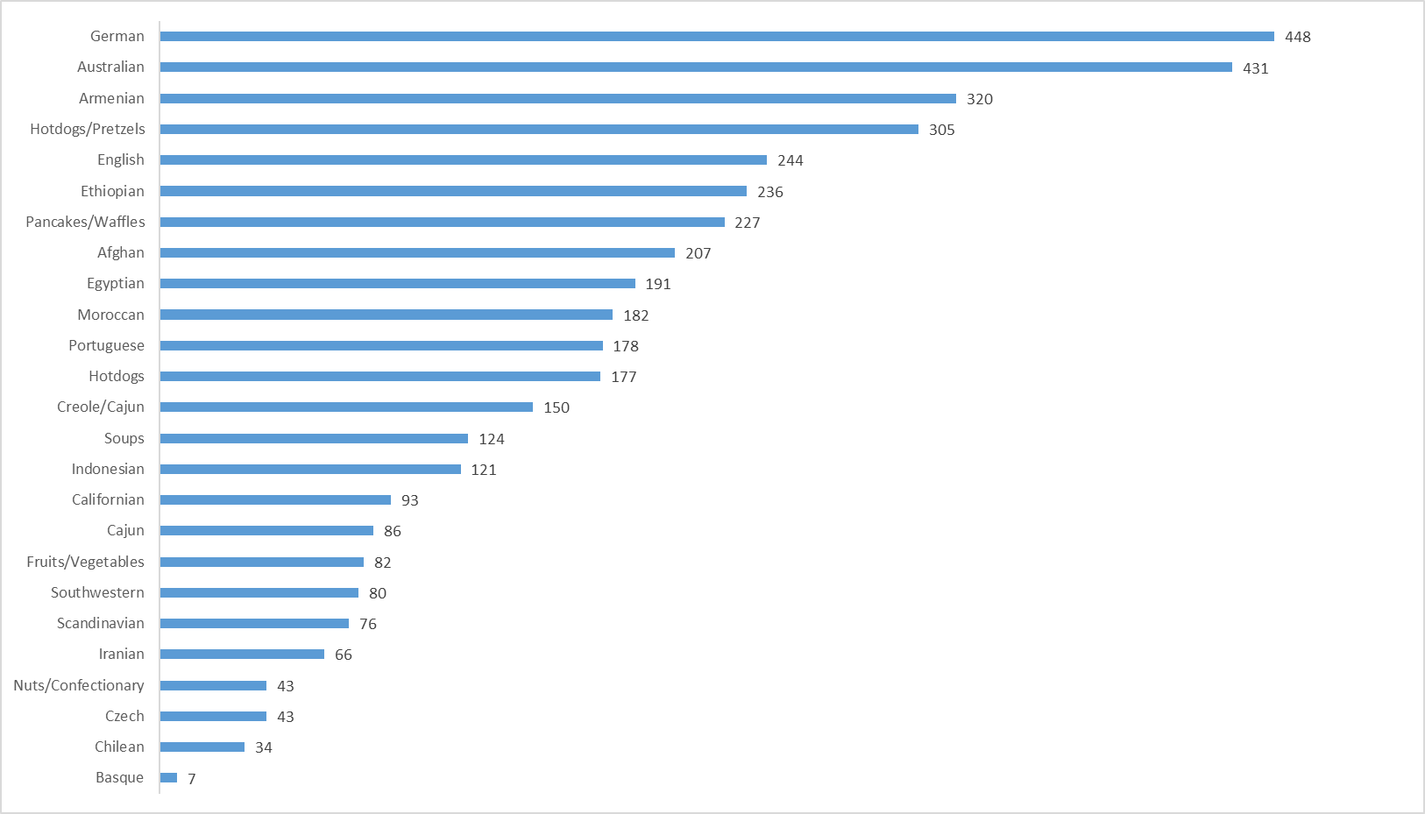
The least prevalent restaurant types in NYC
These are the bottom 20 most frequent cuisine types in NYC across all boroughs

Slide 5
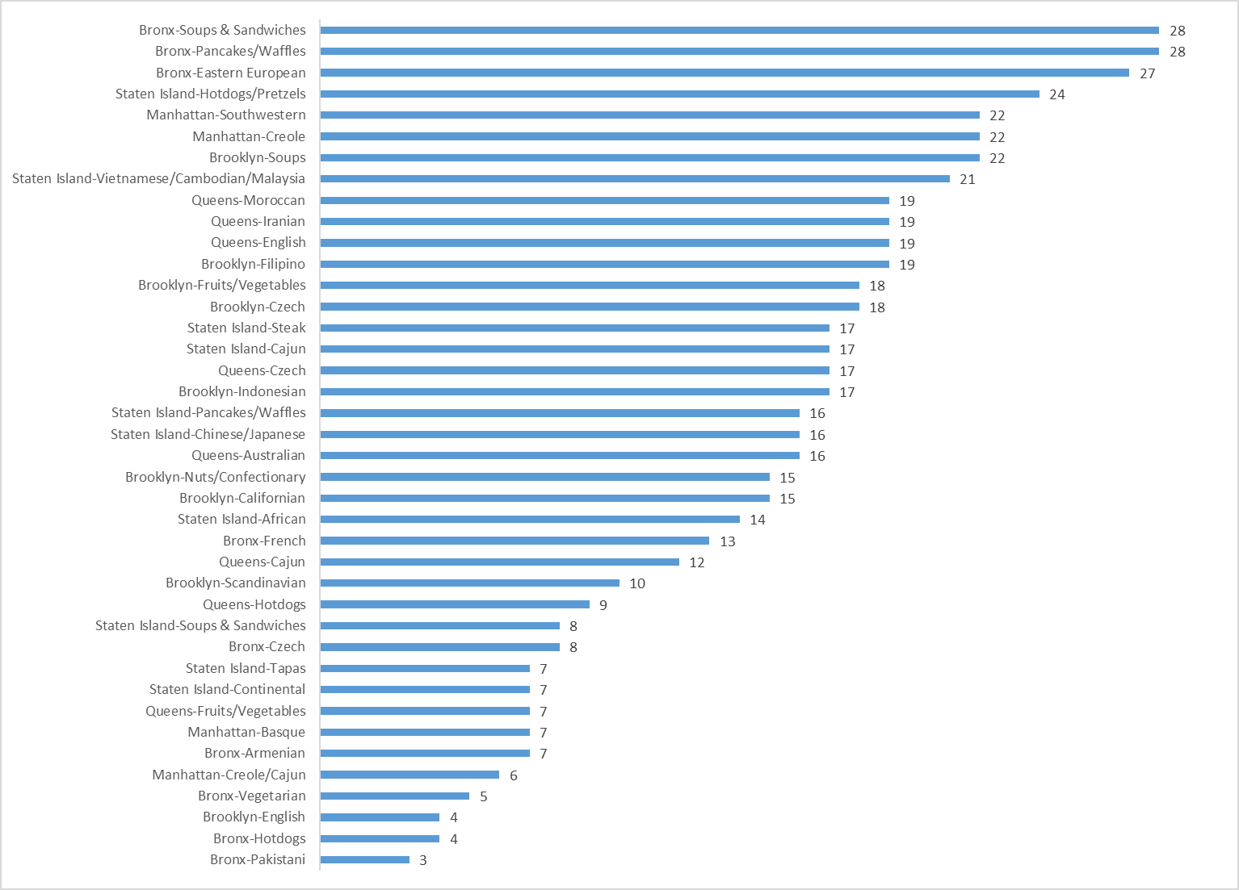
The least prevalent restaurant types in NYC
A further deep dive in to which borough has how many of the low-frequency cuisines reveals more insight

Slide 6
Focusing on 3 cuisines
Having seen the most “absent” cuisines in NYC, we pick the following 3 types as our target cuisines
Hotdogs
This is a fast food, non-specialty type of restaurant
There is scope to have gourmet offerings which are rare
English style
This is a cuisine by itself and is relatively uncommon though well-known
Typically fine ale goes with English cuisine which makes it a lucrative business opportunity
Pancakes
This is yet another well known cuisine which is relatively absent in NYC
As opposed to chains like IHOP, there seems to be an opportunity to provide gourmet home-made style pancakes

Slide 7
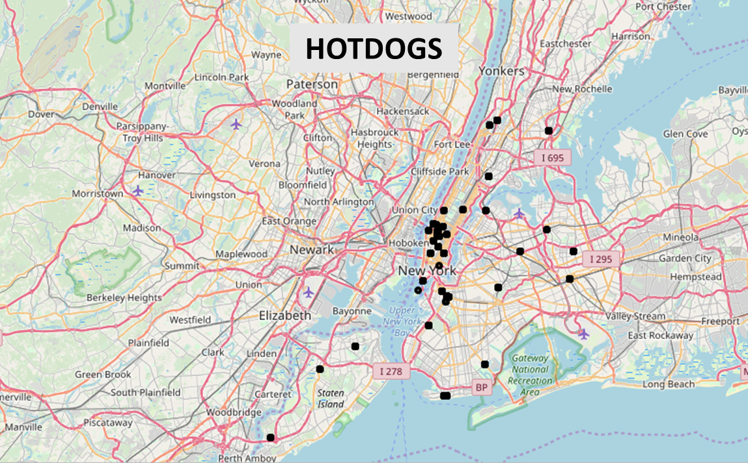
Maps to visualize potential locations
In between JFK and LGA
Staten Island has ample opportunity

Slide 8
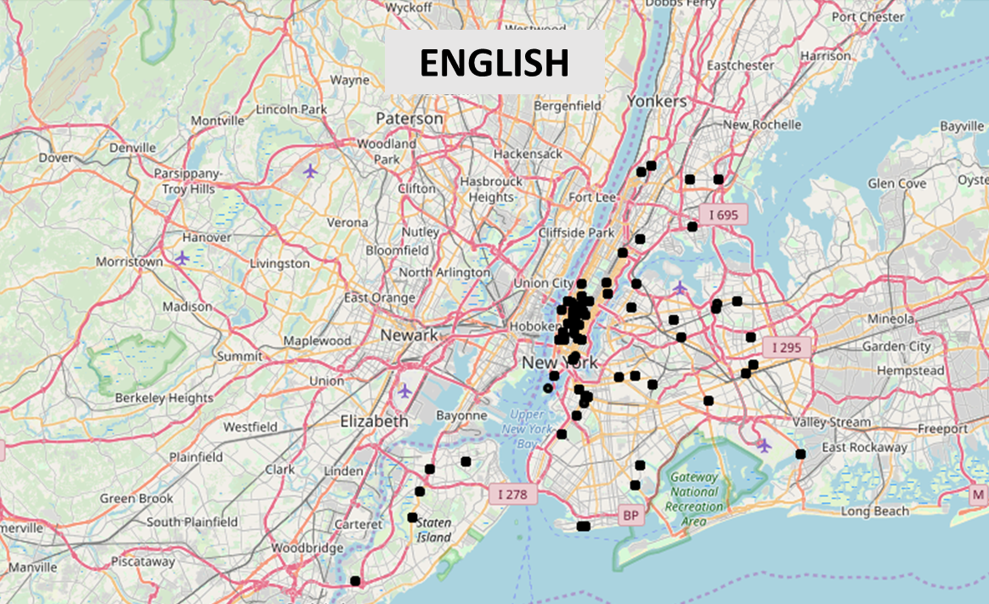
Maps to visualize potential locations
Brooklyn has an opportunity
Staten Island has ample opportunity

Slide 9
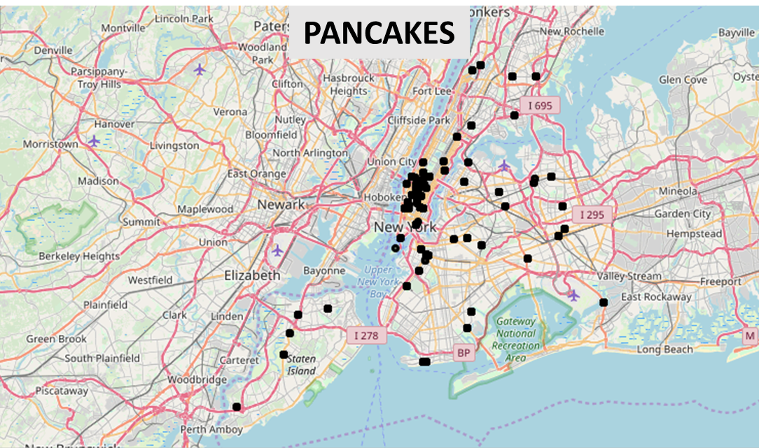
Maps to visualize potential locations
Brooklyn has an opportunity
Staten Island has ample opportunity
In between JFK and LGA

Slide 10
Actionable insights based on analysis and observation
Cuisine
Location
Hotdogs
English style
Pancakes
Staten Island
North Brooklyn
Area between JFK and LGA

